Slide 1
Analyzing Netflix Shows & Movies with SQL
- By Priyanka N

Slide 2
Objective
To help Netflix analyze and draw meaningful insights from a large dataset of shows and movies using SQL. The goal is to identify content trends, viewer preferences, and top-performing media to improve content strategy and user engagement.

Slide 3
Dataset Overview
Tools Used
SQLite: To create tables, import data, and write queries.
VS Code + SQLite extension: SQL editing and terminal-based querying.
Source: Kaggle
Files Used: titles.csv, credits.csv
Total Rows: ~82,000 combined
Columns Include:
title, type, release_year, imdb_score, genres, age_certification, etc.
credits.csv includes actor/director roles and their associations with shows/movies.
Dataset Used :Netflix TV Shows and Movies

Slide 4
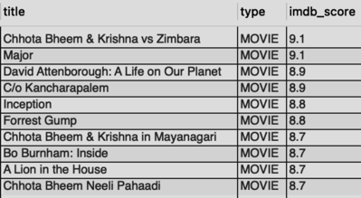
Q1.What were the top 10 movies according to IMDB score?
SELECT title,
type,
imdb_score
FROM shows_movies.titles
WHERE imdb_score >= 8.0
AND type = 'MOVIE'
ORDER BY imdb_score DESC
LIMIT 10

Slide 5
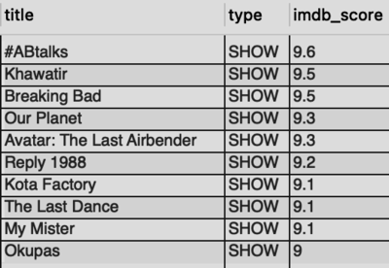
2)What were the top 10 shows according to IMDB score?
SELECT title,
type,
imdb_score
FROM shows_movies.titles
WHERE imdb_score >= 8.0
AND type = 'SHOW'
ORDER BY imdb_score DESC
LIMIT 10

Slide 6
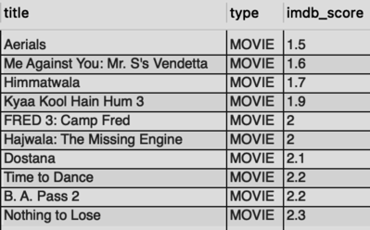
3)What were the bottom 10 movies according to IMDB score?
SELECT title,
type,
imdb_score
FROM shows_movies.titles
WHERE type = 'MOVIE'
ORDER BY imdb_score ASC
LIMIT 10

Slide 7
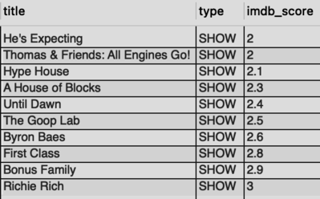
4) What were the bottom 10 shows according to IMDB score?
SELECT title,
type,
imdb_score
FROM shows_movies.titles
WHERE type = 'SHOW'
ORDER BY imdb_score ASC
LIMIT 10;

Slide 8
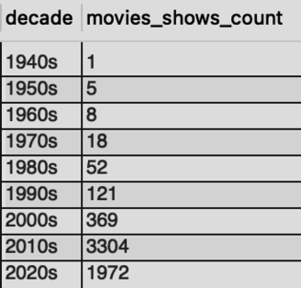
5)Count of movies and shows in each decade
SELECT CONCAT(FLOOR(release_year / 10) * 10, 's') AS decade,
COUNT(*) AS movies_shows_count
FROM shows_movies.titles
WHERE release_year >= 1940
GROUP BY CONCAT(FLOOR(release_year / 10) * 10, 's')
ORDER BY decade;

Slide 9
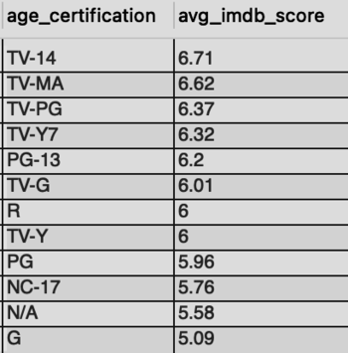
6)What were the average IMDB and TMDB scores for each age certification for shows and movies?
SELECT DISTINCT age_certification,
ROUND(AVG(imdb_score),2) AS avg_imdb_score,
ROUND(AVG(tmdb_score),2) AS avg_tmdb_score
FROM shows_movies.titles
GROUP BY age_certification
ORDER BY avg_imdb_score DESC

Slide 10
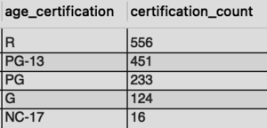
7)What were the 5 most common age certifications for movies?
SELECT age_certification,
COUNT(*) AS certification_count
FROM shows_movies.titles
WHERE type = 'Movie'
AND age_certification != 'N/A'
GROUP BY age_certification
ORDER BY certification_count DESC
LIMIT 5;

Slide 11
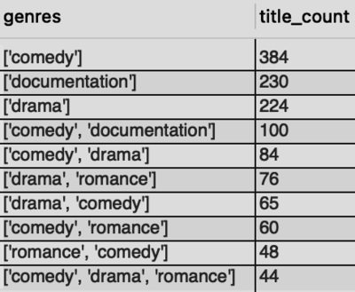
8)Which genres had the most movies?
SELECT genres,
COUNT(*) AS title_count
FROM shows_movies.titles
WHERE type = 'Movie'
GROUP BY genres
ORDER BY title_count DESC
LIMIT 10;

Slide 12
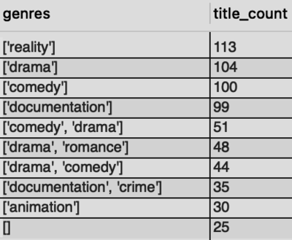
9)Which genres had the most shows?
SELECT genres,
COUNT(*) AS title_count
FROM shows_movies.titles
WHERE type = 'Show'
GROUP BY genres
ORDER BY title_count DESC
LIMIT 10;

Slide 13
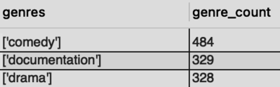
10) What were the top 3 most common genres?
SELECT t.genres,
COUNT(*) AS genre_count
FROM shows_movies.titles AS t
WHERE t.type = 'Movie'
GROUP BY t.genres
ORDER BY genre_count DESC
LIMIT 3;

Slide 14
Conclusion
By using SQL to query and explore Netflix's vast dataset, valuable trends and patterns were identified that could help Netflix make data-driven decisions for content curation. The approach provides a scalable way to analyze entertainment data and can be extended to other streaming platforms.

Slide 15
THANK YOU

